Slide 1

Dependencies are a consequence of modular design
How to manage these dependencies in our code ?

Slide 2

Effets de bord ?

Slide 3
Agenda
1. Modularity
2. Coupling and dependency
3. Control Flow
4. Inversion of control
5. Dependency injection

Slide 4

Coupling and dependency
2
Better alone than in bad company!

Slide 5
Tell me
What is a dependency ?
In software engineering

Slide 6
In computer science, a dependency is a link between two software components

Slide 7
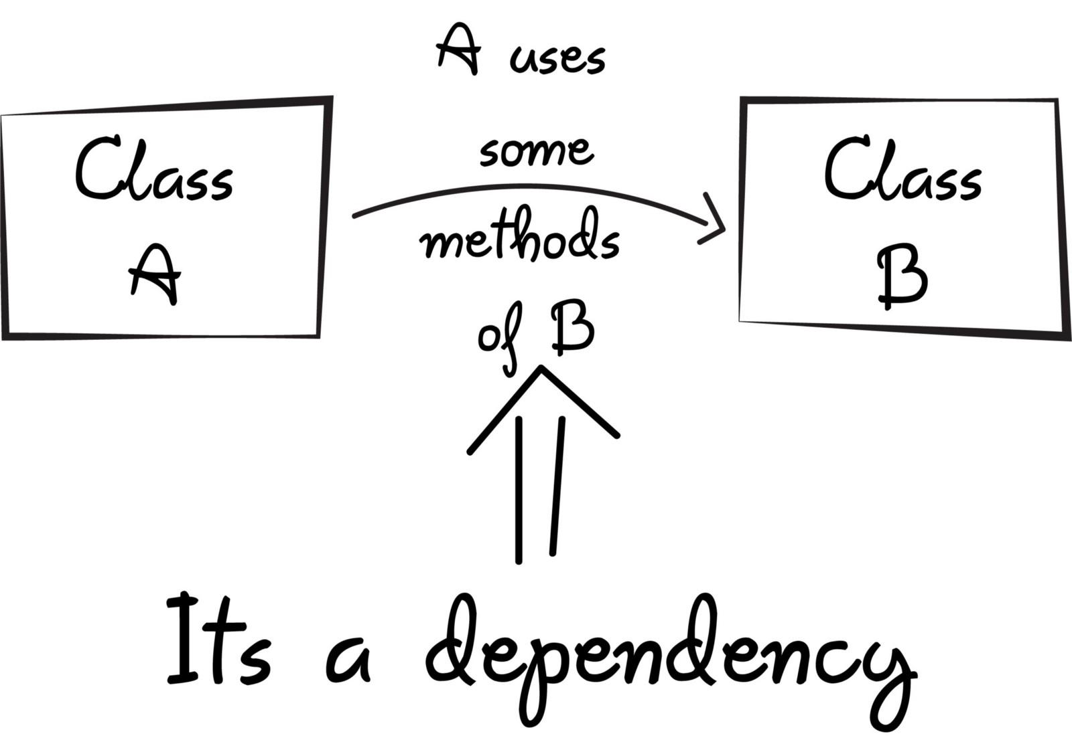
Dependency
A dependency between two classes/component has an impact on their lifecycle

Slide 8
Dependency
Application A
Application B
Module A
Module B
Class A
Class B
Method A
Method B
Dependency principle exists in all levels of a software architecture

Slide 9
Tell me
What is coupling ?
In software engineering

Slide 10
In software engineering, coupling is the degree of interdependence between software components;
@Wikipedia
The number and the strength of the dependencies between two modules

Slide 11
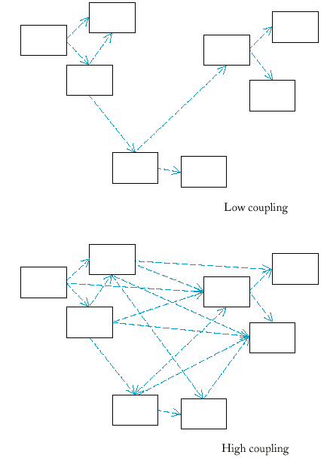
Coupling

Slide 12
Low coupling
A better maintainability, it’s easier to bring some modifications and evolutions
A better testability, it’s easier to test each part of the solution so it provides a greater robustness
Easier to substitute an implementation by another
Easier to understand your program (remember, you are not alone)
Notes:
propagation de modification

Slide 13
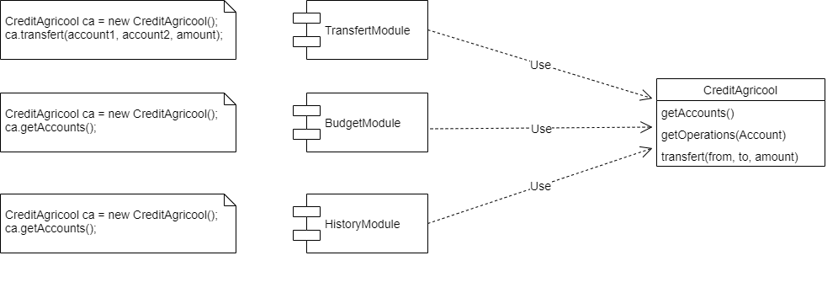
High coupling
Notes:
2 types de relation :
- creation de l’objet credit agricool
- utilisation directe des méthode de l’objet credit agricool

Slide 14

Business Evolve
Look at this free bank with free Gold credit card
We need it

Slide 15
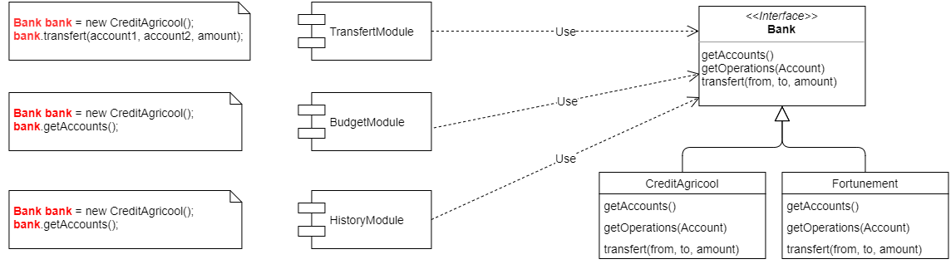
How to reduce coupling ?
Rely on interfaces or abstract classes rather than concrete classes
Notes:
utilisation directe des méthode via l’interface Bank

Slide 16
How to reduce coupling ?
Use creational design pattern like Factory and Abstract Factory
Notes:
Plus de creation de l’objet credit Agricool dans nos module

Slide 17
How to reduce coupling ?
Notes:
Plus de creation de l’objet credit Agricool dans nos module

Slide 18
How to reduce coupling ?
Dependency Inversion Principle
“Dependencies refer only to abstractions, not to concretions”
Rely on interfaces or abstract classes rather than concrete classes
Use creational design pattern like Factory and Abstract Factory
Other kind of solutions based on design patterns (Proxy, Publish / suscribe), Java Service Provider…
Notes:
p90

Slide 19
How to reduce coupling ?
Still some dependencies, but we reduce coupling by following Dependency Inversion Principle
We see that there is link between flow of control and coupling
We are on the road of building a plugin architecture, which is low coupling architecture

Slide 20
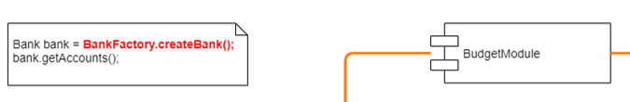
Tell me
How to go further ?
Does BudgetModule should be responsible of calling BankFactory ?

Slide 21

Control flow
3
Better than the Eminem’s flow

Slide 22
Tell me
What is control flow ?
Or flow of execution

Slide 23
The control flow
It’s the way and the order of how the software pieces are executed
Software pieces : statements, functions, code blocks, software components…)
Unclear flow of control led to unmaintainable program

Slide 24
Library 1
Library 2
Program’s code
Flow of control
Library 3

Slide 25
The flow of control
Should be compared to data flow
Should be compared to the direction of the dependencies

Slide 26

Inversion of Control (IoC)
4
Don’t call us, we’ll call you

Slide 27
Reduce coupling
In nominal case, application is responsible of the flow of control
This responsibility create dependencies between the program and the different parts of it
A good way to reduce dependencies even more is to delegate the flow of control to a third party

Slide 28
Inversion of Control
Delegate the flow of control to a third party is the principle of Inversion Of Control
Inversion of Control is an architectural pattern

Slide 29
Libraries
IoC
Library 1
Application
code
Library 2
Application
code
Application code
Framework
Flow of control
Flow of control
Library 3
Application
code

Slide 30
IoC implementations
Several design patterns implement the IoC pattern
Dependency injection Container
Scheduler
Service locator (JNDI for Java)
The most used pattern is Dependency injection (DI)

Slide 31

Dependency Injection (DI)
5
Petite piqure de rappel

Slide 32
Dependency Injection is an implementation of IoC where the dependencies are dynamically injected at runtime

Slide 33
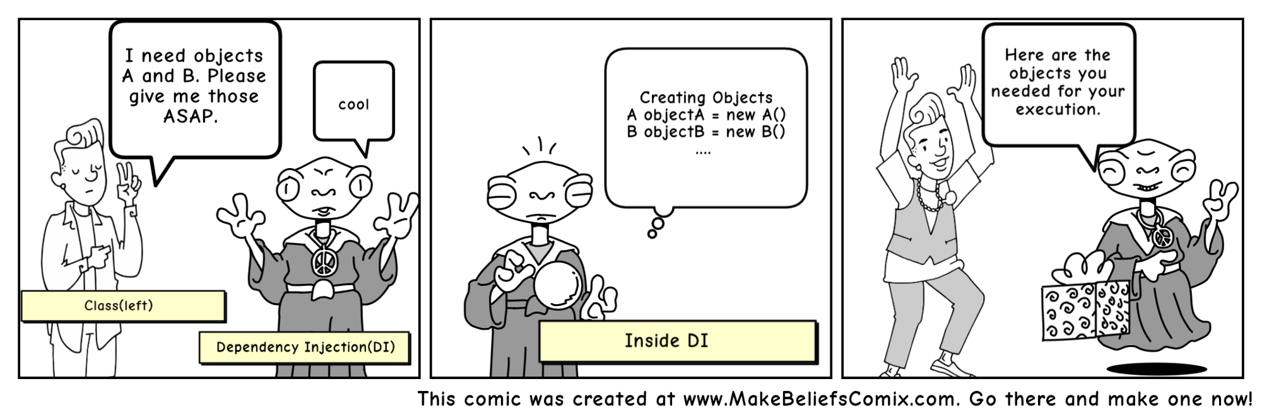
Dependency Injection

Slide 34
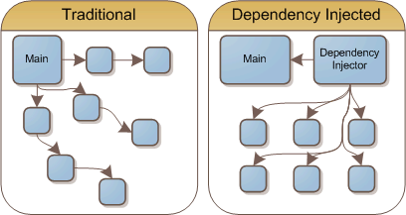
Dependency Injection

Slide 35
Dependency Injection
Class A
Class B
Class C
Client
Uses
Uses
Uses
Class A
DI
Class B
Client
Inject
Create & assemble
Class C

Slide 36
Why Dependency Injection ?
Reduce coupling
Reduce coupling between client and a given dependency
Simplify application extension
Allows to plug different implementation of a given dependency (plugin mindset)

Slide 37
Why Dependency Injection ?
Simplify unit testing
Provides different implementations according to the running context to be able to mock some external services, infrastructure component like database… Simplify mocking
Cleaner code
Remove boilerplate code of creation and management of dependencies

Slide 38
Tell me
How to go further ?
Does BudgetModule should be responsible of calling BankFactory ?

Slide 39
Credits
Special thanks to all the people who made and released these awesome resources for free:
Presentation template by SlidesCarnival
Photographs by Unsplash
Notes:
https://www.cs.bham.ac.uk/~mdr/teaching/modules04/java2/MyBigJava/Ch07/ch07.html
https://medium.freecodecamp.org/a-quick-intro-to-dependency-injection-what-it-is-and-when-to-use-it-7578c84fa88f
https://spring.io/blog/2007/07/11/setter-injection-versus-constructor-injection-and-the-use-of-required/

